Slide 1
Software Engineering
Software engineering is an engineering branch associated with development
of software. Software engineering deals with-
Scientific principles
Methods
Procedures

Slide 2
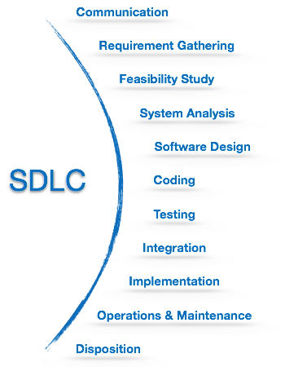
SDLC
Software Development
Life Cycle

Slide 3
Communication:
Client initiates the request for a desired software product
Client contacts the service provider and tries to negotiate the terms
Client submits his request to the service providing organization in writing
Requirement Gathering
The team holds discussions with various stakeholders.
Team bring out as much information as possible on their requirements.
Conducting interviews of users and developers.

Slide 4
Feasibility Study:
Team comes up with a rough plan of software process.
Team analyzes if a software can be made to fulfill all requirements.
Financially, practically and technologically feasible for the organization.
System Analysis:
Developers decide a roadmap of their plan.
Bring up the best software model suitable for the project.
Conducting interviews of users and developers.

Slide 5
Software Design:
Logical design and physical design.
Logical diagrams.
Data-flow diagrams.
Coding:
Known as programming phase.
Bring up the best software model suitable for the project.
Conducting interviews of users and developers.

Slide 6
Testing:
50% of whole software development process should be tested.
Module testing, program testing, product testing.
Discovery of errors and their remedy
Integration:
Integration of software with outer world entities.
Implementation:
Installing the software on user machines.
Software is tested for portability and adaptability.
Integration related issues are solved during implementation.

Slide 7
Operation and Maintenance:
Documentation on how to operate the software
How to keep the software operational
Software is maintained timely by updating the code
Hidden bug fix
Real world related problem
Disposition:
It may go completely obsolete
May need intense up gradation
This phase includes archiving data.

Slide 8
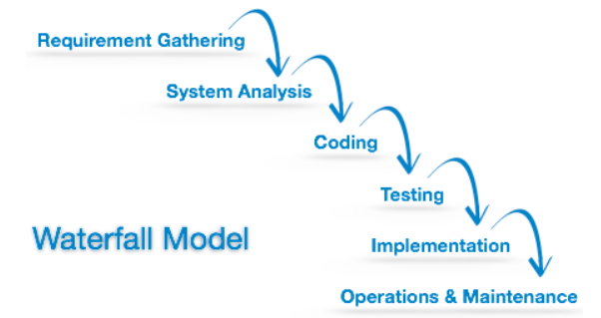
Waterfall Model

Slide 9
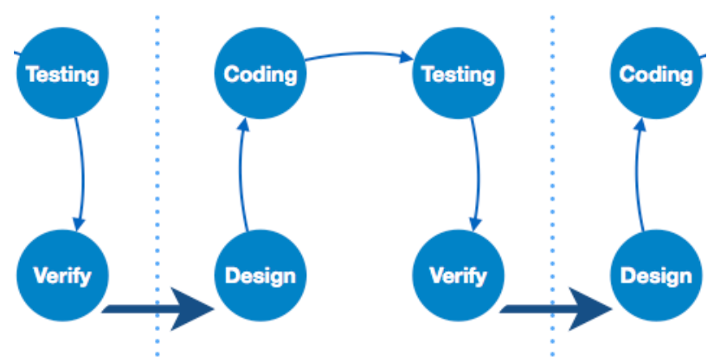
Iterative Model

Slide 10
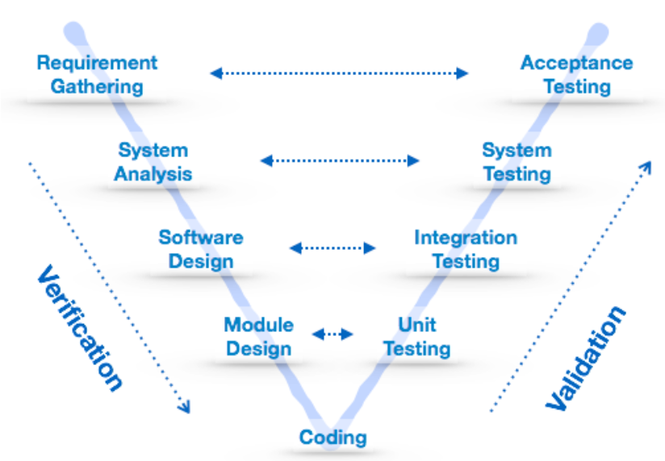
V Model

Slide 11
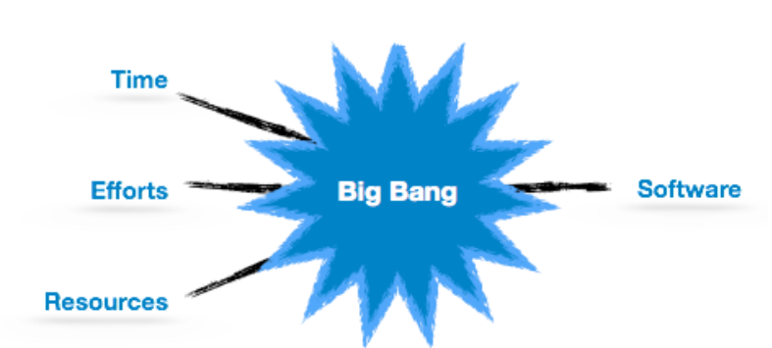
Big Bang Model

Slide 12
RAD (Rapid Application Development) Model
Gathering requirements using workshops or focus groups
Prototyping and early, reiterative user testing of designs
The re-use of software components
A rigidly paced schedule that refers design improvements to the next product version
Less formality in reviews and other team communication

Slide 13
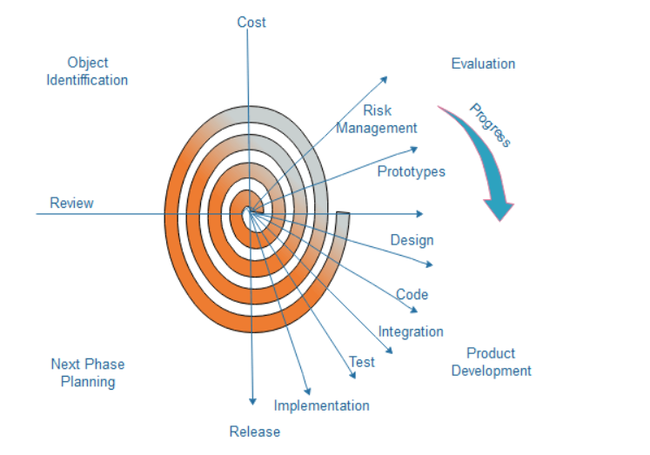
Spiral Model
Customer communication
Planning-
Risk Analysis-
Development-
Assessment-

Slide 14
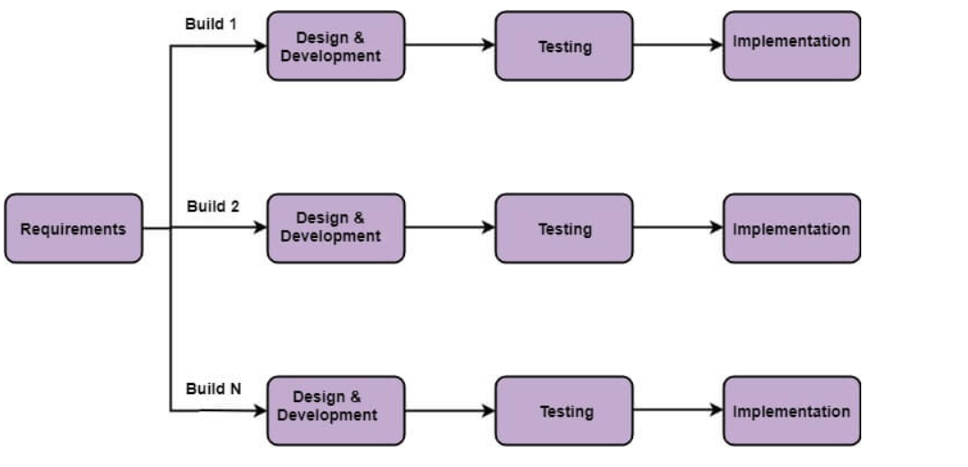
Incremental Model

Slide 15
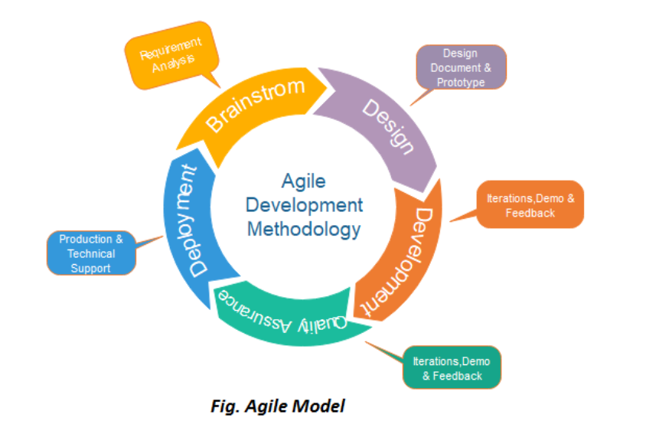
Agile Model
Requirements gathering
Design the requirements
Construction/ iteration
Testing/ Quality assurance
Deployment
Feedback

Slide 16
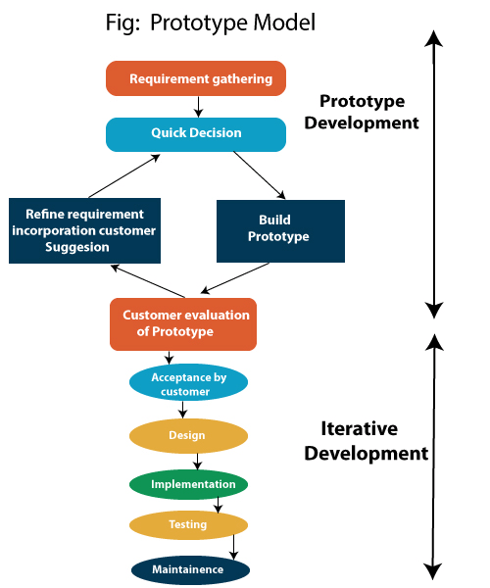
Prototype Model
Requirement Gathering
Quick Decision
Build a Prototype
Assessment or User Evaluation
Prototype Refinement
Engineer Product

Slide 17
Project Scheduling
Identify all the functions required to complete the project.
Break down large functions into small activities.
Determine the dependency among various activities.
Establish the most likely size for the time duration required to complete the activities.
Allocate resources to activities.
Plan the beginning and ending dates for different activities.
Determine the critical path. A critical way is the group of activities that decide the duration of the project.

Slide 18
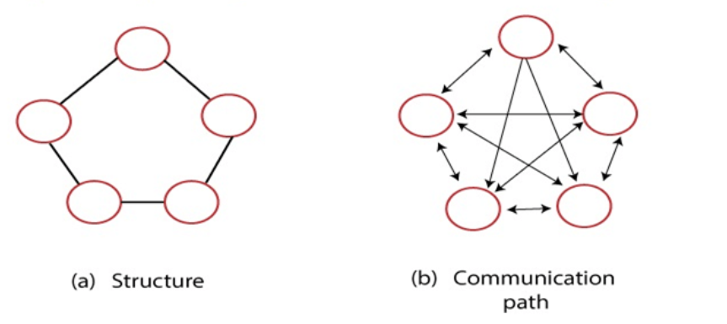
Ego-Less or Democratic Teams

Slide 19
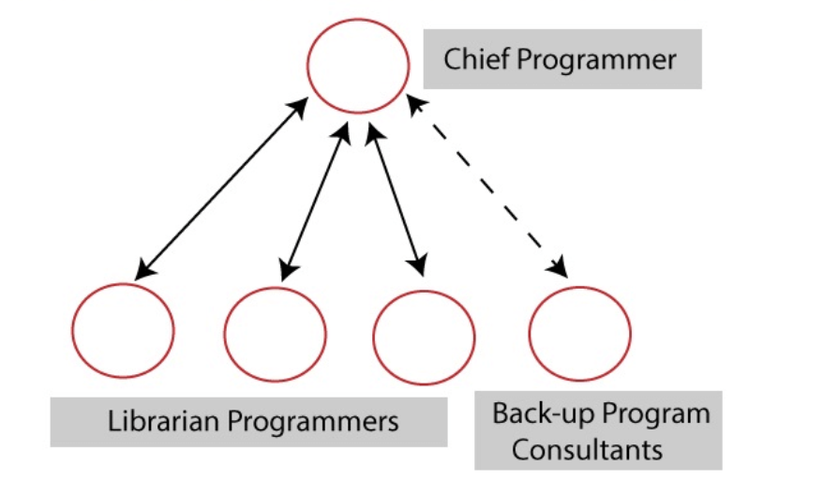
Chief Programmer Team

Slide 20
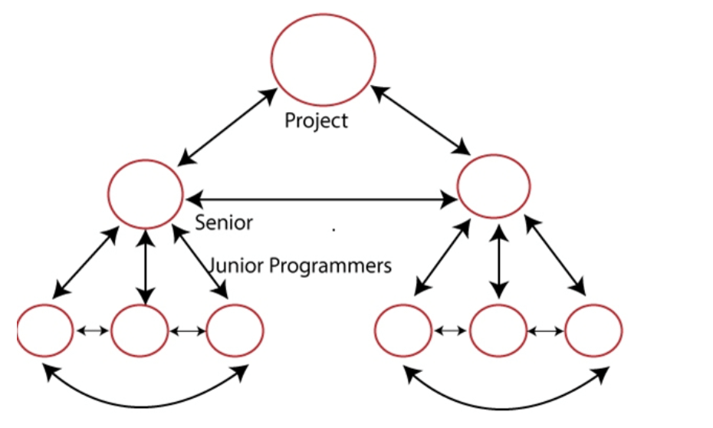
Hierarchical Team Structure

Slide 21
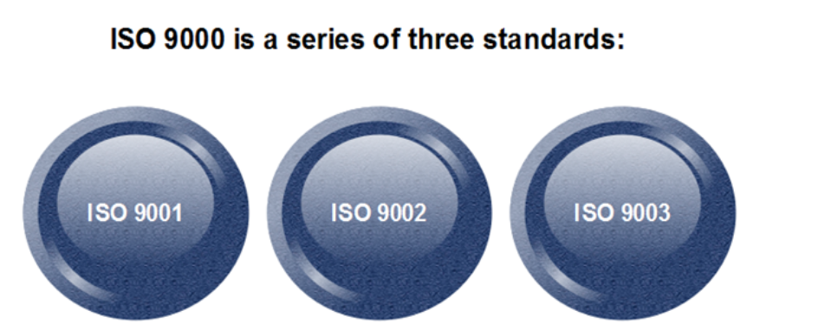
Types of ISO 9000 Quality Standards
ISO 9001: This standard applies to the organizations engaged in design, development,
production, and servicing of goods.
ISO 9002: This standard applies to those organizations which do not design products
but are only involved in the production.
ISO 9003: This standard applies to organizations that are involved only in the
installation and testing of the products.

